Slide 1
OBJECT EMMBEDDING AND LINKING

Slide 2
OLE:
Object Linking and Embedding is a technology developed by Microsoft that allows embedding and linking to documents and other objects.
OLE is a means of communication which allows any application to directly use and manipulate other windows application.
OLE specification permits the user to link and embed objects and also edit the object within the container application.

Slide 3
What is OLE?
OLE (Object Linking and Embedding) is a means to interchange data between applications.
OLE enables the user to edit the data in which it is created.
For Eg: When a spreadsheet is edited in Visual Basic the original application is called.

Slide 4
OLE Server:
This is an application that can provide objects to other applications. This is also called as OLE Source application.
OLE Client:
This is an application that uses objects provided by OLE Server. This is also called as OLE Container as it contains objects provided by OLE Server.
Not every application is an OLE Server. Only a few applications are capable of providing objects. In the same way not all applications are capable of receiving objects. However, there are applications, such as MS-Word and MS-Excel that are capable of being OLE source as well as OLE Container.

Slide 5
How OLE Works
Embedding
Linking
Server Application
Server Application
Object copied
Object linked
Container Application
Container Application

Slide 6
How OLE Works
Embedding
Linking
If you modify the source object
Server Application
Server Application
Link updates and retrieves current source object
Embedded (copied) object does not change
Destination Application
Destination Application

Slide 7
The OLE Container Control
Permits an OLE object to be added to a form
Insert an OLE Object at design time
Place an OLE container control on a form
The Insert Object dialog box displays (see next slide)
Insert an OLE Object at run time
Place an OLE container control on a form
Click the Cancel command button on the Insert Object dialog box, and add code to insert the object later
In-place activation
Allows direct editing of the OLE object placed in the OLE container control

Slide 8
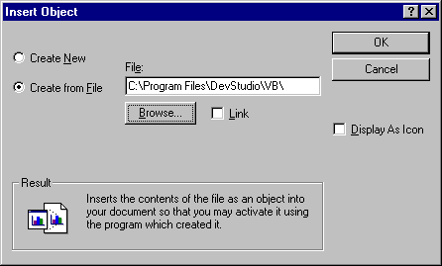
OLE Container Control Insert Object dialog box
Create a new object
Insert an object at runtime
Create a object from an existing file
Display only an Icon
Link an existing object

Slide 9
Embedded objects:
When an embedded object is created, all the data associated with that object is contained in the object.
For example, if a spreadsheet is an embedded object, all the data associated with the cells would be contained in the OLE container control or insert able object, including any necessary formulae.

Slide 10
Moving or sizing the OLE container:
The OLE container control has an Object Move event, which is triggered when the object associated with the control is moved or resized.
An Object Move event occurs when the user moves or resizes the object contained in the OLE container control.

Slide 11
Automation:
Visual Basic technology that allows us to use code and objects from other Windows applications in our applications called OLE Automation
Referenced application (such as Word or Excel) must be available on the end user’s computer.
Linked object - original object remains stored in original file and is linked to container document
Container document - the compound document that contains elements from multiple applications

Slide 12
OLE Automation Objects
OLE Automation is an industry standard technology that applications use to expose their OLE objects to development tools, macro languages, and other applications that support OLE automation.
For example, a spreadsheet application may expose a worksheet, chart cell, or range of cells all as different types of objects.
When an application supports OLE automation, the objects it exposes can be accessed by Visual Basic. Visual Basic could be used to manipulate these objects by invoking methods on the object or by getting and setting the object’s properties.

